Slide 1
Asset Pricing in Chinese capital market
Fangzhou Lu
NYU Stern, Decemeber 5th, 2012

Slide 2
Why we may be interested?
China is the second biggest economy in the world in terms of GDP.
Some people are guessing that China’s total GDP will surpass the US’s total GDP very soon

Slide 3
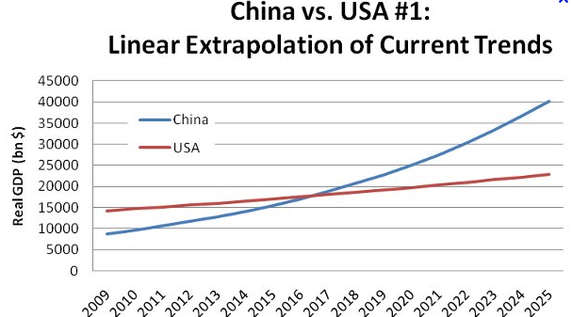
China versus US’s GDP

Slide 4
Question
What is China’s capital market like?
What’s the history of Chinese equity market?
What is its difference from mature market?
What make the study of asset pricing particularly interesting in Chinese capital market’s framework?

Slide 5
Asset pricing vocabulary
CSRC(Chinese securities regulatory commission)=US SEC
SOEs(State-own Enterprise)
SMEs(Small and medium Enterprise)
ChiNext=Chinese “Nasdaq”
QFII and QDII: Qualified foreign/domestic institutional investors

Slide 6

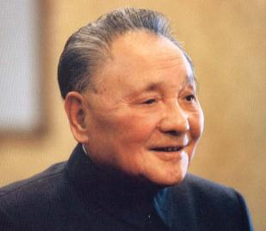
Capital market origins
Deng:Market Economy within socialism and one party’s framework
Jeffery Sachs: Shock Therapy

Slide 7
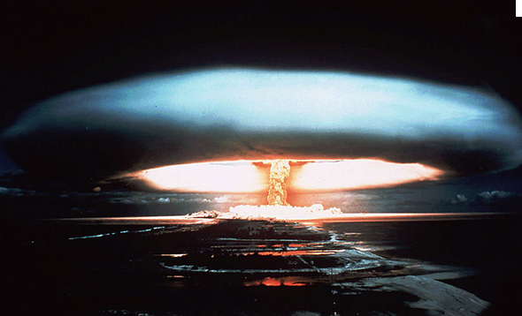
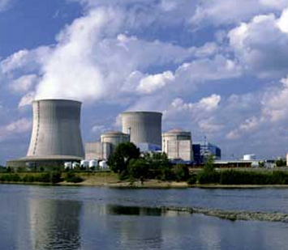
What makes the key difference?

Slide 8
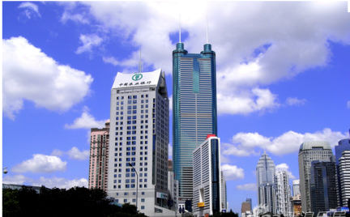
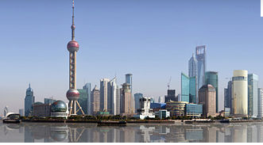
History of Capital markets in China
Phase I: Establishment of China’s Capital Markets, 1978-1992
Shenzhen stock exchange (1990) Shanghai stock exchange (1990)

Slide 9
History of Capital markets in China
Phase II: Creation of an integrated, uniformly regulated capital market in China (establishment of CSRC in 1992), 1993-1998
Phase III: New securities Law and non-tradable share unlock. SME Board in Shenzhen, commercial paper in bond market. QFII and QDII. 1999-2008
Phase IV Post-financial crisis: Stock index future, short sale and ChiNext(China’s Nasdaq)

Slide 10
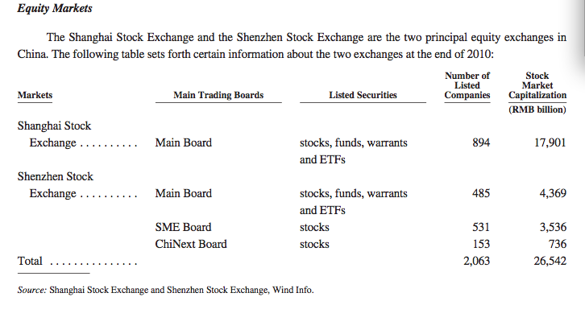
Market Highlight: equity market

Slide 11
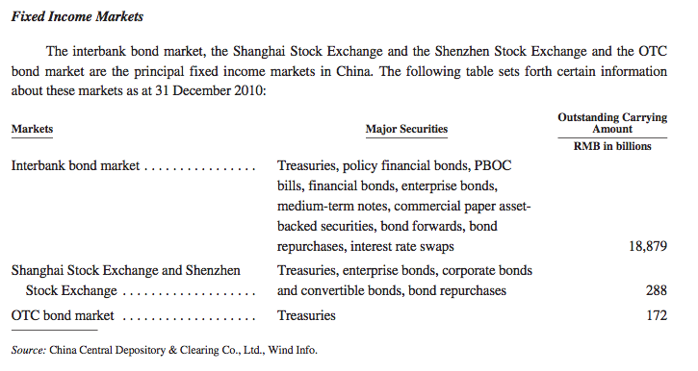
Market Highlight: bond market

Slide 12
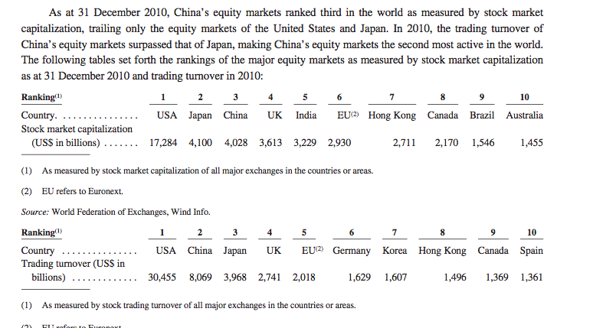
Third largest equity markets around the world

Slide 13
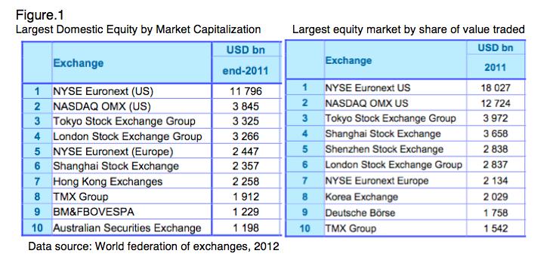
Largest equity markets around the world

Slide 14
Hottest Asset Pricing puzzles in China
Underperformance puzzle of the Chinese equity market
Equity pricing puzzle in segmented market
Stock Synchronicity
Housing asset bubbles
Ownership and agency problem in non-tradable shares unlock
Bond market and derivatives market

Slide 15
Key differences we should notice when studying asset pricing
Historical reason
Market establishment time and theory establishment time
Capital inflow control and other controls
Unique economic and political position

Slide 16
Key input into the formula
Information asymmetry
Legal system incompleteness
Political system’s influence on economic efficiency and asset pricing
Financial market incompleteness

Slide 17
Information asymmetry at what level?
More serious in emerging markets
Between SOEs and private companies
Between majority shareholders and minority shareholders
Between Institutional investors and retail investors
Between Domestic and foreign investors

Slide 18
Legal System incompleteness
Inside trading and stock price manipulation
illegal manipulations of financial statements in listed sector
Lack of protection for retail investors
Problems come from CSRC!

Slide 19
Political System’s influence on economic efficiency and asset pricing
The influence is ambiguous
Pros: SOEs are superior because their operations with be more compatible with government’s economic goal for the nation which will be beneficial for the country in the long run. (Ex: industrial structure reform)
Government settle down fiscal policies much faster.
Cons: SOEs create great inefficiency. No democracy.

Slide 20

Political System’s influence on economic efficiency and asset pricing
What do public and hedge managers think?
Yes, the communist party’s market

Slide 21
Financial market incompleteness
New Innovations
Stock index future, short sales permission, ChiNext board
On its way
Full short sales permission, Global board, (ChiNext)^2

Slide 22
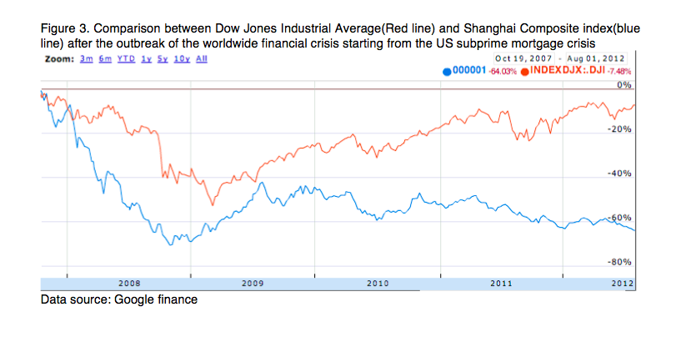
Underperformance puzzle of the equity market

Slide 23
Underperformance puzzle of the equity market
The overcorrection of asset price due to the permission of short sales of stock market index(a reason derived from financial market incompleteness and its development)
The depression of the asset price by the central government
The poor asset and dividends claim rights held by small shareholders due to the legal system incompleteness

Slide 24
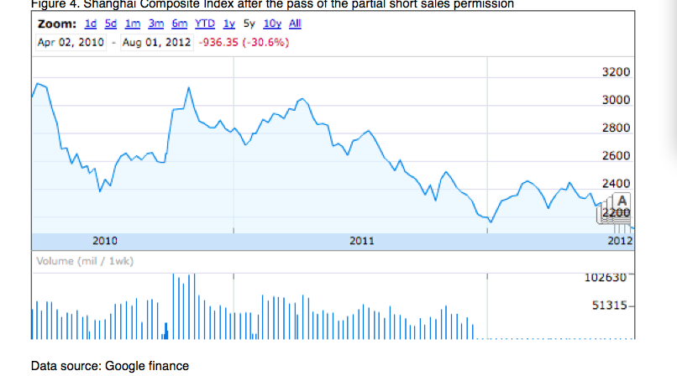
Underperformance puzzle of the equity market short sales depress equity prices

Slide 25
Short sales permission and liberalization
Supporters:
Decrease cost of capital
Decrease upside minus downside R square measurement
Timing is the key!
Opponents:
Strong negative stock returns and negative skewness
Exaggerate stock drops during a Recession

Slide 26
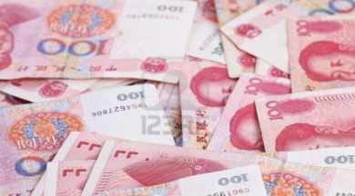
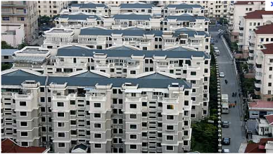
Underperformance puzzle of the equity market government intervention
High inflation
High housing price

Slide 27
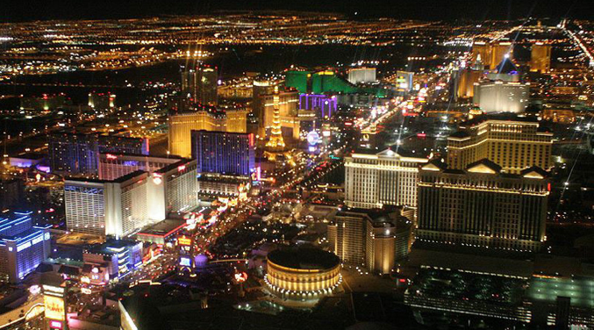
Underperformance puzzle of the equity market Poor asset claim right

Slide 28
Equity pricing puzzle in segmented market
Background
 | Regulator | Investor | Trading Currency | Company traded | Overall Market Cap
A share | CSRC | Mainland | RMB | All kinds of firms | Huge
B share | CSRC | Foreigners | USD(SZ),HKD(SH) | Middle-cap | Trivial compare to A
H share | HKSI | Foreigners | HKD | Selected blue-chip | Trivial compare to A

Slide 29
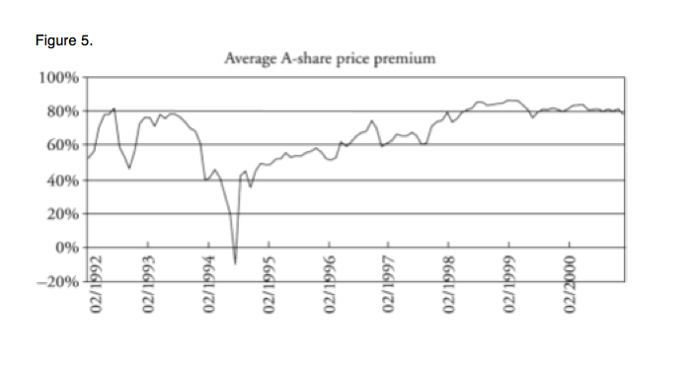
Equity pricing puzzle in segmented market What is unusual?

Slide 30
Equity pricing puzzle in segmented market Hypothesis
Differential demand hypothesis
Liquidity preference hypothesis
Differential risk hypothesis
Information asymmetry hypothesis
Short sale constraint hypothesis (for H)
Currency preference hypothesis

Slide 31
Equity pricing puzzle in segmented market Recent development
Domestic investors are qualified to invest in B-share market
Alternative investment channels: QDII and QFII

Slide 32
Stock synchronicity
High internal synchronicity and low external correlation
For developing countries, a single corporation’s bad news or good news can turn out to be widely influential and will arise general fear or optimism because of other corporations’ information opacity.

Slide 33
Stock synchronicity
Heavily depend on export (Lack of diversity)
(Brazil)
Less information in the market
Government ownership
Does not correlate with world market

Slide 34
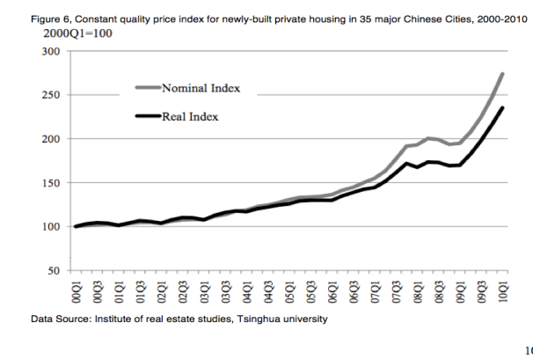
Housing asset bubbles
Analogy between US housing market crash and China housing market crash?

Slide 35
Housing asset bubbles Hypothesis
Government intervention to get revenue
Political reason and GDP
Lack of Alternative investment
Rigid demand created by fear
Success in marriage market, promote social status

Slide 36
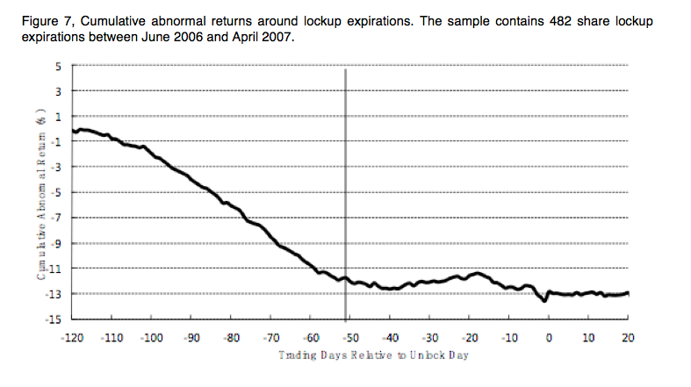
Ownership and agency problem in non-tradable shares unlock

Slide 37
Ownership and agency problem in non-tradable shares unlock
Supply and Demand?
Information asymmetry
Efficiency gain?
Similarity to other problem: Majority shareholder and Minority shareholder
IPO unlock

Slide 38
Conclusion and Outlook
Information asymmetry
Legal system incompleteness
Political system’s influence on economic efficiency and asset pricing
Financial market incompleteness

Slide 39
Conclusion and Outlook
Derivative pricing in an in complete market framework
The construction of a more complete bond market
Robert Mundell’s EuroZone experience: A good theory may instruct the development of a new financial system

Slide 40
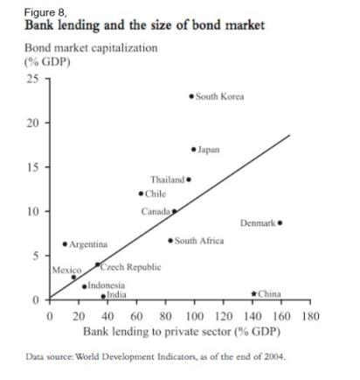
Banking lending and size of bond market

Slide 41
Signals that need a more complete bond market
Stressed by governor of China Central bank Zhou Xiaochuan
Many high quality private companies cannot be well funded because SOEs take all the fund away from national gigantic banks in China
Gigantic banks are issuing “special financial product” which has its essence as mortgage-back securities

Slide 42
Problems with construction of fix income market
Lack of sound rating agencies
CSRC’s ignorance
SOEs lack the motivation to help with the construction the market

Slide 43
Thank you !
Much to be searched there☺

